Slide 1


Slide 2
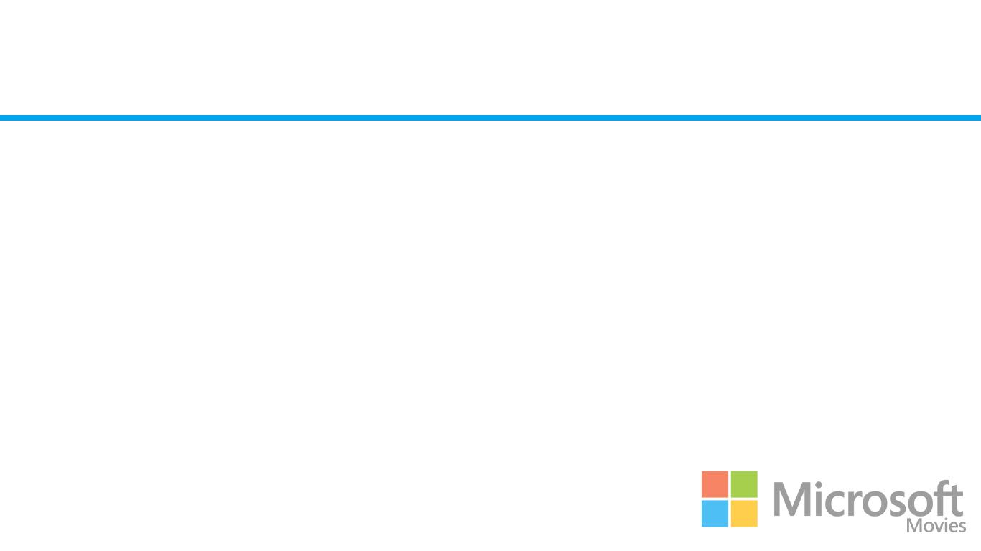
Summary
Original movie content is the next big frontier to be conquered by Microsoft. And as usual they are expected to be one of the biggest contenders in the market. But how can we make Microsoft Movies a success? By targeting the top genres and studios in today’s movie market.

Slide 3
Outline
Business Problem
Data
Methods
Results
Conclusions

Slide 4
Business Problem
The biggest companies in the world are now creating original video content. So of course Microsoft should be too. But with today’s technology where do we even begin?
What movies are most successful in today’s market?
What attributes make it a success?
And who are making the most successful movies today?

Slide 5
Data
To answer those 3 questions I have used 3 datasets from 2 of the most reputable movie information sources:
Box Office Mojo (bom.movie_gross)
IMDB (imdb.title.basics,imdb.title.ratings)
This data provide insights into viewer ratings, revenue generated, movie studios and timings of some of the top movies from the past 12 years.

Slide 6
Methods
To measure the success of a movie I used the two values, average rating and total value. I then posed 3 questions that I would analyse the data to answer:
What genres of movies have proved to be most successful?
Which movie studios have produced the most successful movies?
Does the runtime of a movie correlate to its success?

Slide 7
Results - Most successful Genres
I started by relating my genres to my two success areas and my conclusions were:
Measuring Success by average rating proved ineffectual:
this showed a very even playing field with genres ranging in rating from 5 - 7.2 but there was no obvious correlations between the genre and the rating
Measuring Success by Total Revenue showed a clear result
Notes:
Initially I began by trying to measure the result of the movie on it’s average rating. This proved to be ineffective as even the best movies had a very standard rating. So I changed tactic and looked at it from an organisational view and obviously success is measured in revenue. And this presented with a very clear trend.

Slide 8
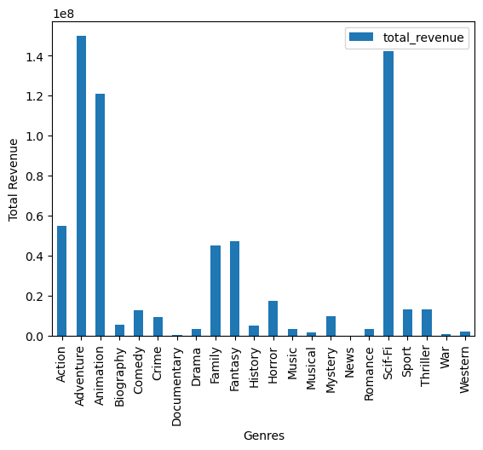
Results - Most successful Genres
From this bar graph we can clearly see the top 3 genres of movies with the highest median revenues:
Adventure
Animation
Sci-Fi

Slide 9
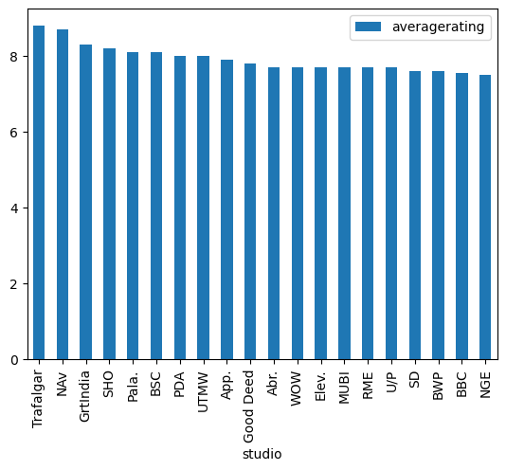
Results - Most successful Studios
I again started by relating my genres to my two success areas and my conclusions were:
Measuring Success by average rating proved ineffectual:
Once again the average ratings were very similar and there were a lot more studios than genres this time so I needed to find another method
Notes:
Initially I began by trying to measure the result of the movie on it’s average rating. This proved to be ineffective as even the best movies had a very standard rating. So I changed tactic and looked at it from an organisational view and obviously success is measured in revenue. And this presented with a very clear trend.

Slide 10
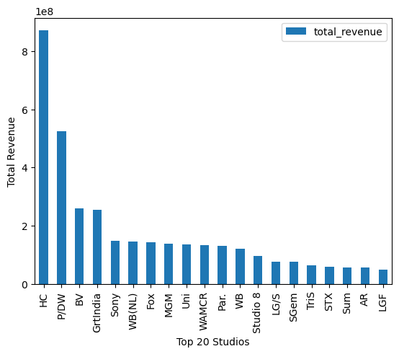
Results - Most successful Genres
When analysing success of a studio against total revenue we were easily able to find the top 20 studios as seen in this bar graph.

Slide 11
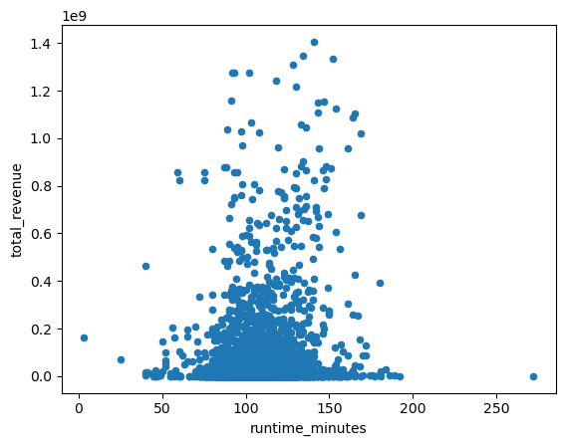
Results - Does Runtime Matter?
For this final question I wanted to calculate the correlation coefficient between runtime and Revenue. This would tell us if the length of the movie impacts its success.
The correlation factor of runtime to total revenue = 0.14949065557391722
This is also represented in the scatter plot which seems to have no shape or pattern whatsoever.
Thus there is no correlation between the length of a movie and it’s success.

Slide 12
Conclusions
My 3 conclusions for the future of the Microsoft Movies project are:
The top 3 genres of movies are Adventure, Animation and Sci-Fi. I would recommend creating original content in those genres to maximise revenue.
The most successful movie studios are: HC and P/DW. I would recommend collaborating with them on future movie projects and emulating their success
Runtime does not influence revenue. Scientists have told us our attention spans are getting shorter and shorter but thankfully this does NOT correlate to our enjoyment of movies so my recommendation would be to produce movie content of good quality instead of focusing on length.

Slide 13
Thank You!
Email: nysmitch@gmail.com
GitHub: @nysmitch
LinkedIn: linkedin.com/in/nyssamitchell/

